Slide 1

17 Irrefutable Laws of Teamwork
By John Maxwell

Slide 2

Introduction
To achieve great things, you need a team. Building a winning team requires an understanding of these principles.
Whatever your goal or project, you must add value and invest in your team so the end product benefits from more ideas, energy, resources, and perspectives.

Slide 3

1. The Law of Significance
People try to achieve great things by themselves mainly because of their ego size, level of insecurity, or simple naiveté and temperament.
One is too small a number to achieve greatness.

Slide 4

2.The Law of the Big Picture
The goal is more important than the role. Members must be willing to subordinate their roles and personal agendas to support the team vision.
By seeing the big picture, effectively communicating the vision to the team, providing the needed resources, and hiring the right players, leaders can create a more unified team.

Slide 5
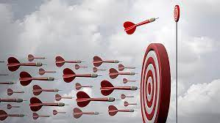
3. The Law of the Niche
All players have a place where they add the most value.
Essentially, when the right team member is in the right place, everyone benefits.
To be able to put people in their proper places and fully utilize their talents and maximize potential, you need to know your players and the team situation.
Evaluate each person’s skills, discipline, strengths, emotions, and potential.

Slide 6

4. The Law of Mount Everest
As the challenge escalates, the need for teamwork elevates.
Focus on the team, and the dream should take care of itself.
The type of challenge determines the type of team you require:
  A new challenge requires a creative team.
  An ever-changing challenge requires a fast, flexible team.
  An Everest-sized challenge requires an experienced team.
See who needs direction, support, coaching, or more responsibility.
Add members, change leaders to suit the challenge of the moment, and remove ineffective members.

Slide 7
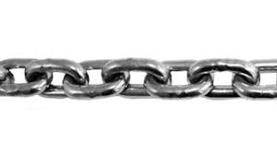
5. The Law of the Chain
The strength of the team is impacted by its weakest link.
When a weak link remains on the team the stronger members identify the weak one, end up having to help him, come to resent him, become less effective, and ultimately question their leader’s ability.

Slide 8

6. The Law of the Catalyst
Winning teams have players who make things happen.
These are the catalysts, or the get-it-done-and-then-some people who are naturally intuitive, communicative, passionate, talented, creative people who take the initiative, are responsible, generous, and influential.

Slide 9
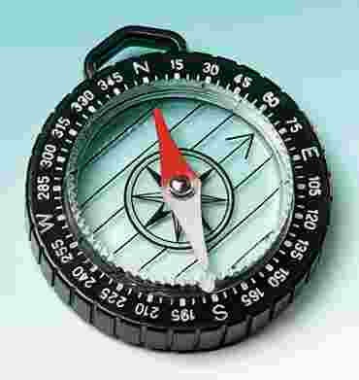
7. The Law of the Compass
A team that embraces a vision becomes focused, energized, and confident. It knows where it’s headed and why it’s going there.
A team should examine its Moral, Intuitive, Historical, Directional, Strategic, and Visionary Compasses.
  Does the business practice with integrity?
  Do members stay?
  Does the team make positive use of anything contributed by previous teams in the organization?
  Does the strategy serve the vision?
  Is there a long-range vision to keep the team from being frustrated by short-range failures?

Slide 10

8. The Law of The Bad Apple
Rotten attitudes ruin a team.
The first place to start is with yourself.
Do you think the team wouldn’t be able to get along without you?
Do you secretly believe that recent team successes are attributable to your efforts, not the work of the whole team?
Do you keep score regarding the praise and perks handed out to other team members? Do you have a hard time admitting you made a mistake?
If you answered yes to any of these questions, you need to keep your attitude in check.

Slide 11

9. The Law of Countability
Teammates must be able to count on each other when it counts.
Is your integrity unquestionable?
Do you perform your work with excellence?
Are you dedicated to the team’s success?
Can people depend on you?
Do your actions bring the team together or rip it apart?

Slide 12

10. The Law of the Price Tag
The team fails to reach its potential when it fails to pay the price.
Sacrifice, time commitment, personal development, and unselfishness are part of the price we pay for team success.

Slide 13
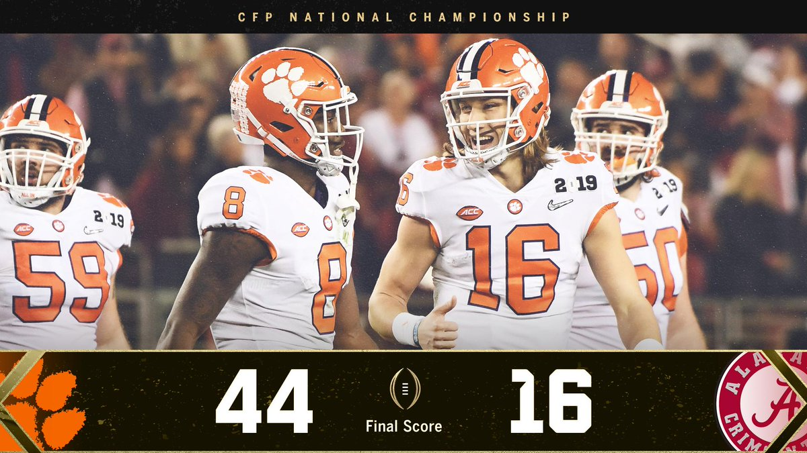
11. The Law of the Scoreboard
The team can adjust when it knows where it stands.
The scoreboard is essential to evaluating performance at any given time and is vital to decision-making.

Slide 14

12. The Law of the Bench
Great teams have great depth.
Any team that wants to excel must have good substitutes as well as starters.
The key to making the most of the law of the bench is to improve the team continually.

Slide 15

13. The Law of Identity
Shared values define the team.
The values you choose for the team will attract the type of members you need.
Values give the team a unique identity to its members, potential recruits, clients, and the public.
Values must be constantly stated and restated, practiced, and institutionalized.

Slide 16

14. The Law of Communication
Interaction fuels action.
Effective teams have teammates who are constantly talking and listening to each other. From leader to teammates, teammates to the leader, and among teammates, there should be consistency, clarity, and courtesy.
People should be able to disagree openly but with respect.
Between the team and the public, responsiveness, and openness is key.

Slide 17

15. The Law of the Edge
The difference between two equally talented teams is leadership.
A good leader can bring a team to success, provided values, work ethic and vision are in place.
The Myth of the Head Table is the belief that on a team, one person is always in charge in every situation.
Understand that another person may be best suited for leading the team in particular situations.
The Myth of the Round Table is the belief that everyone is equal, which is not true.
The person with greater skill, experience, and productivity in a given area is more important to the team.
Compensate where it is due.

Slide 18

16. The Law of High Morale
When you’re winning, nothing hurts.
A team with high morale can deal with whatever circumstances are thrown at it.

Slide 19

17. The Law of Dividends
Investing in the team compounds over time.
Make the decision to build a team and decide who among the team are worth developing.
Gather the best team possible, pay the price to develop the team, do things together, delegate responsibility and authority, and give credit for success.

Slide 20
Conclusion
Are there any laws that stood out to you the most?
Are there any laws with which you would disagree?

